Slide 1



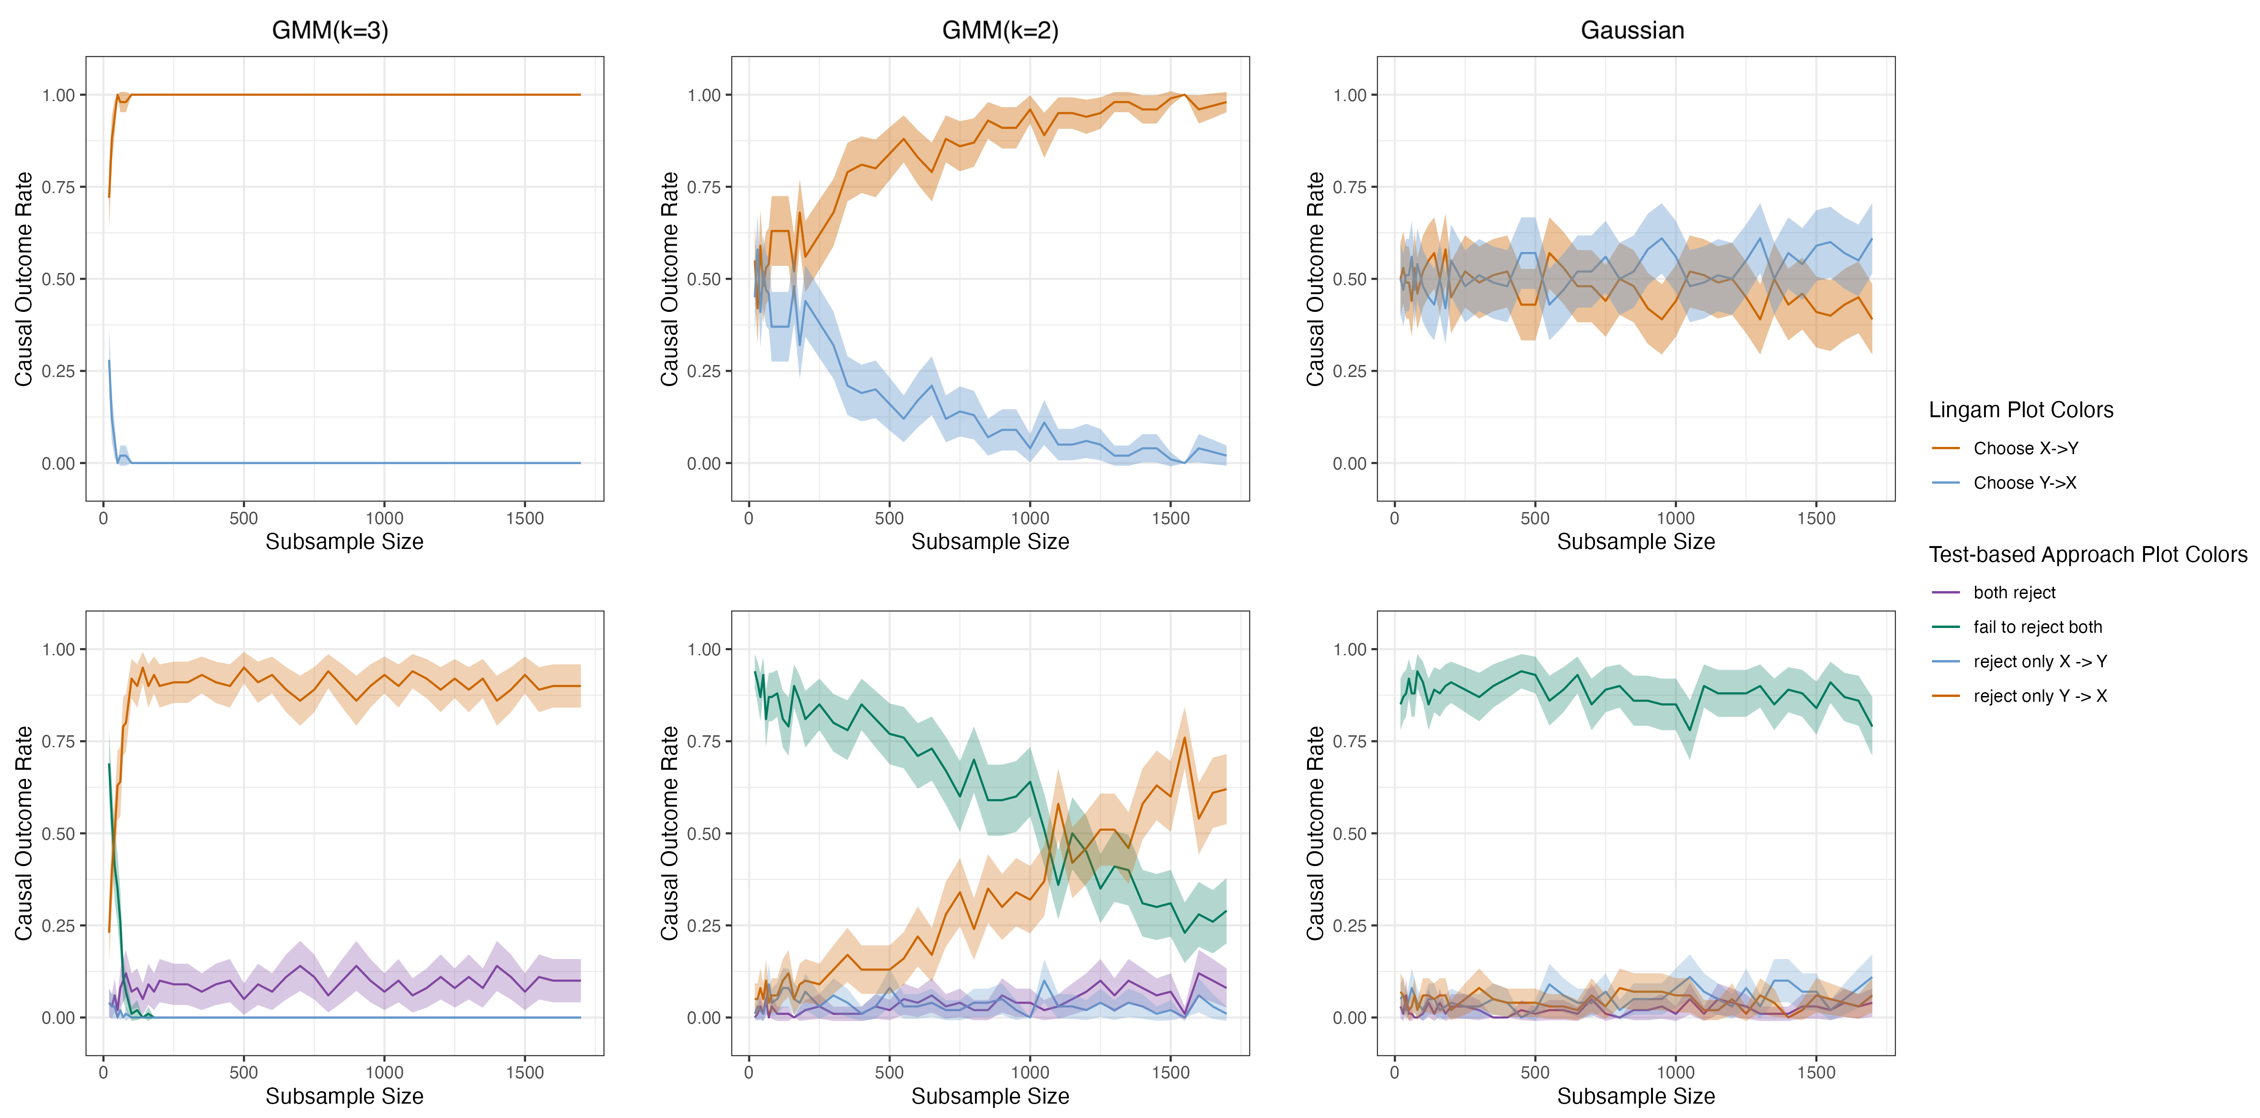
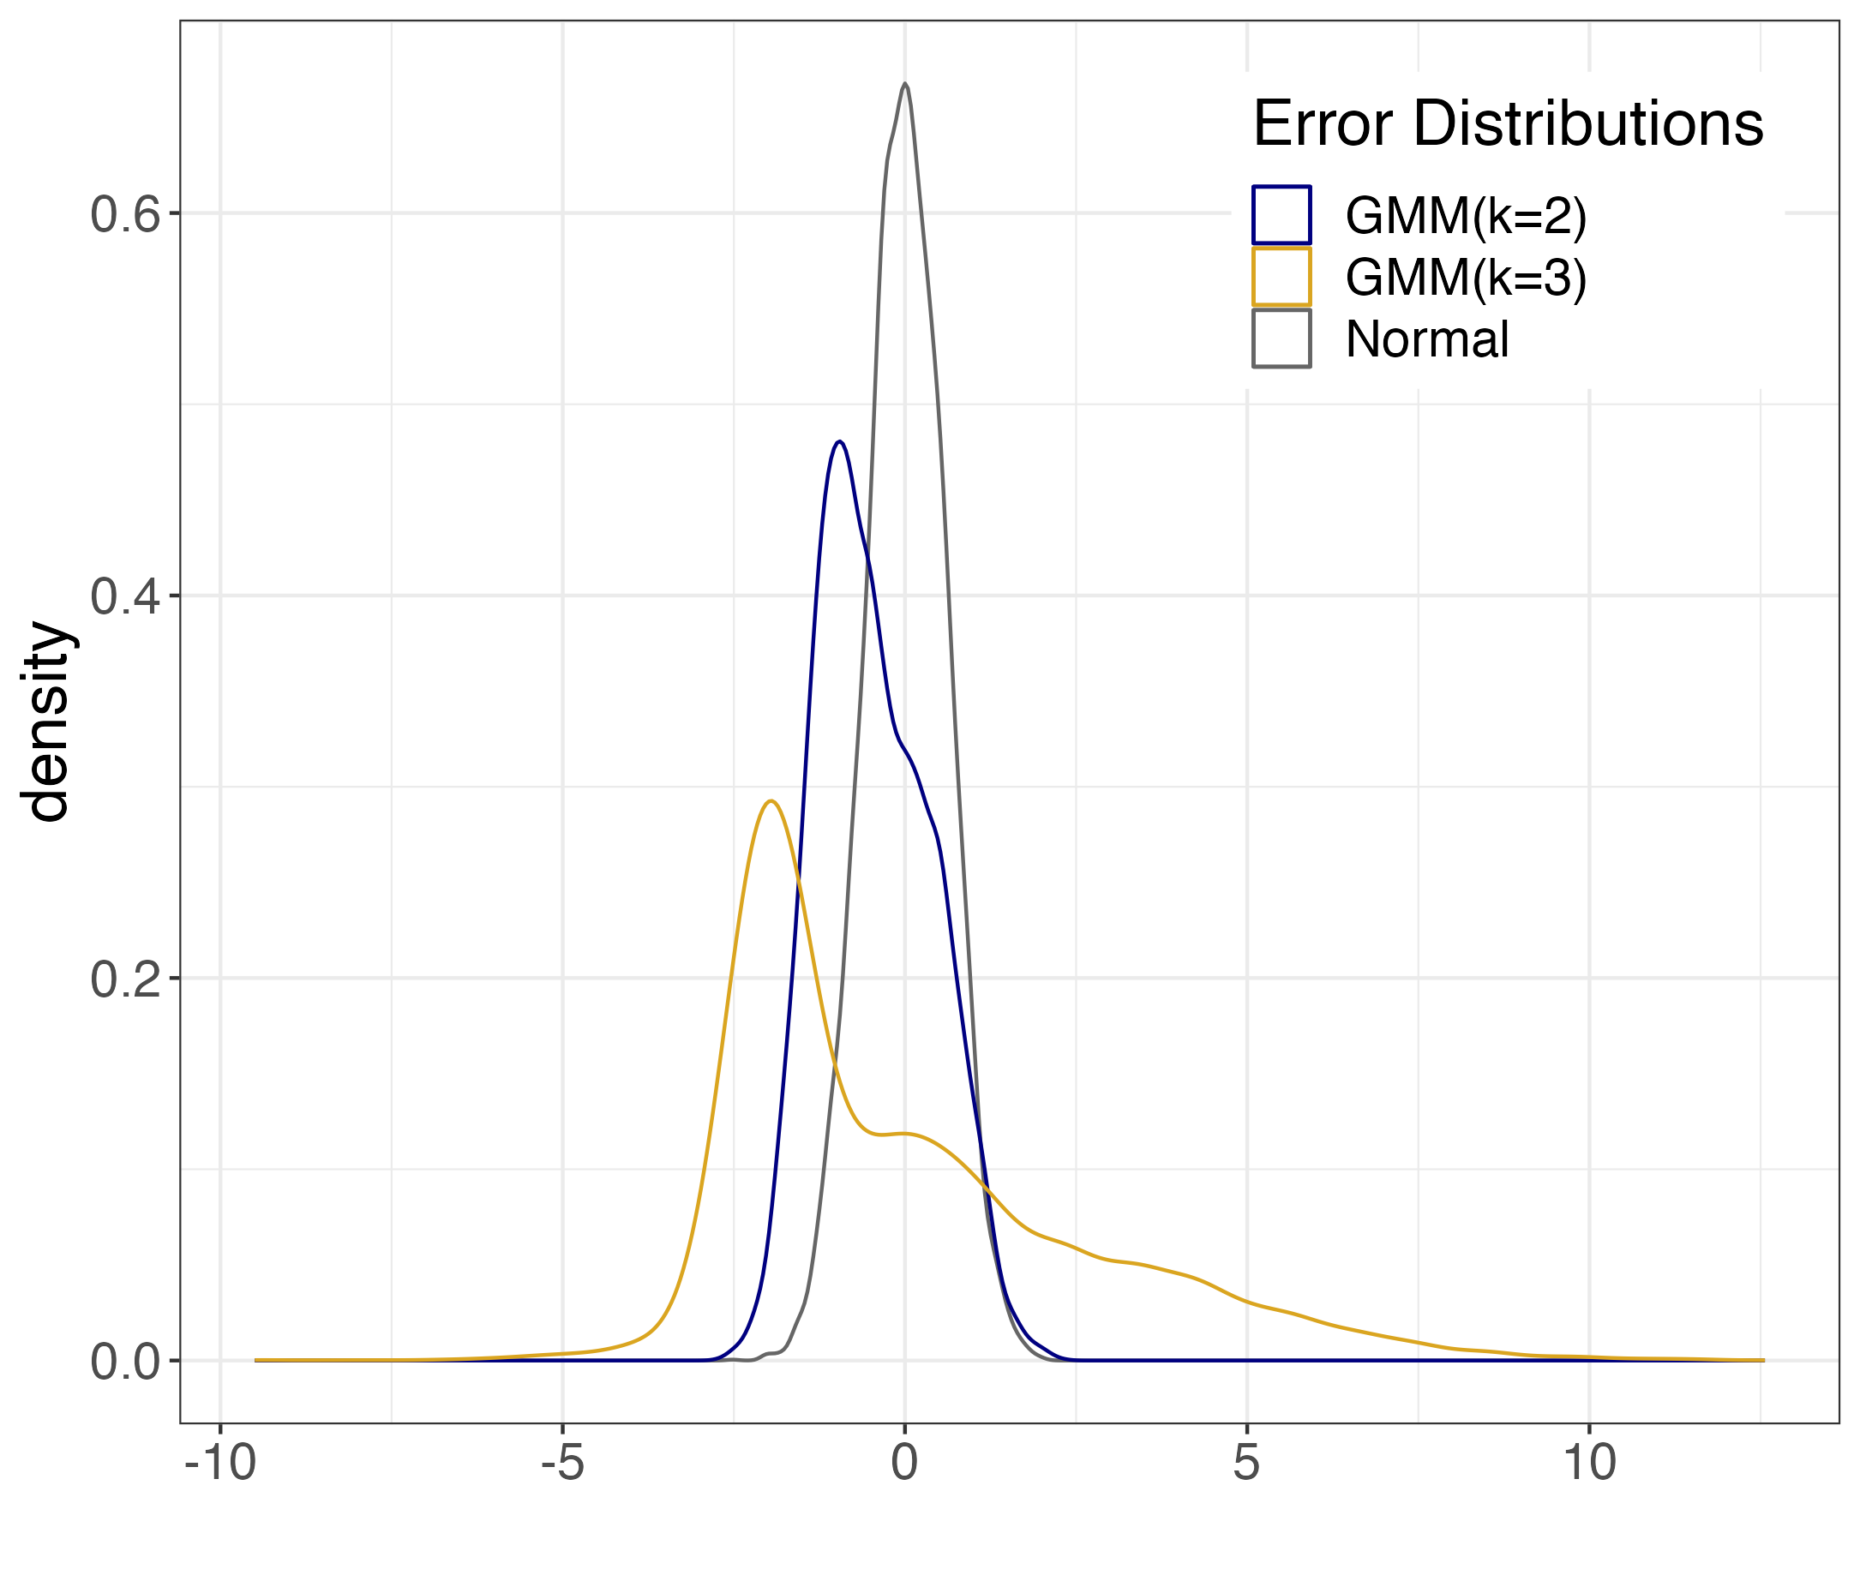
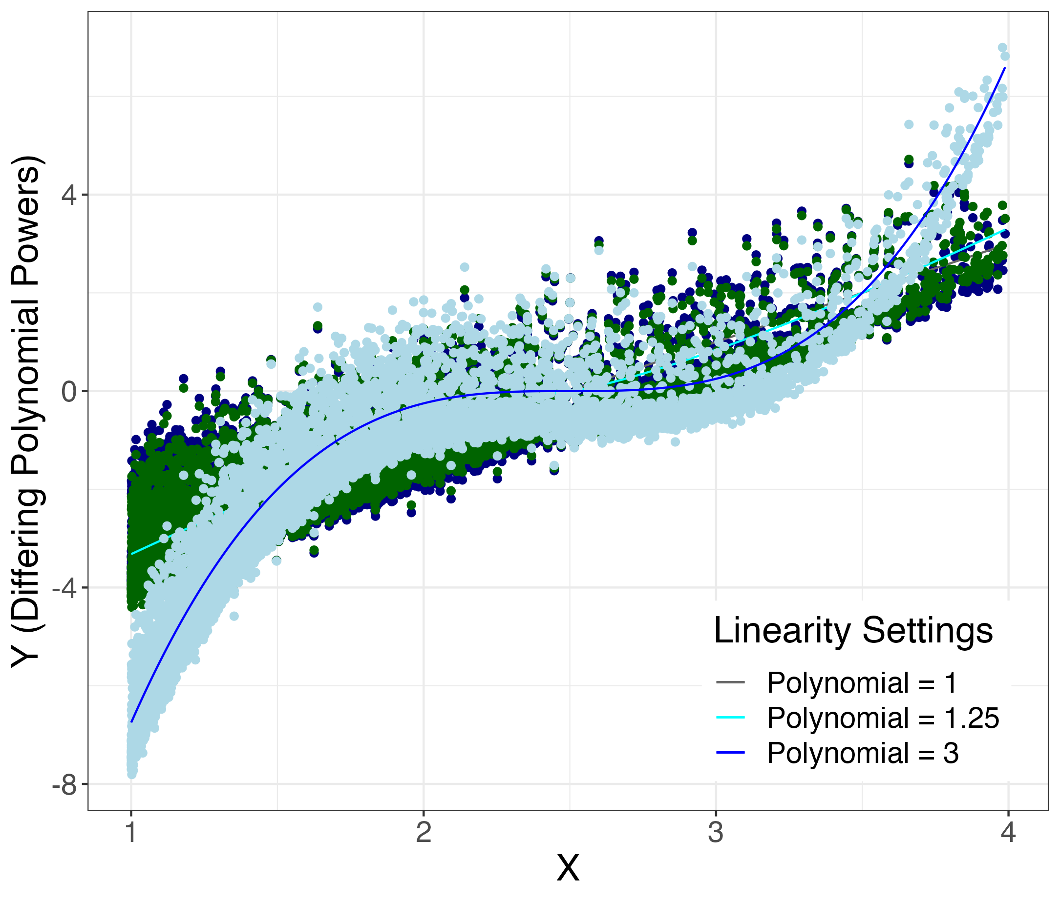
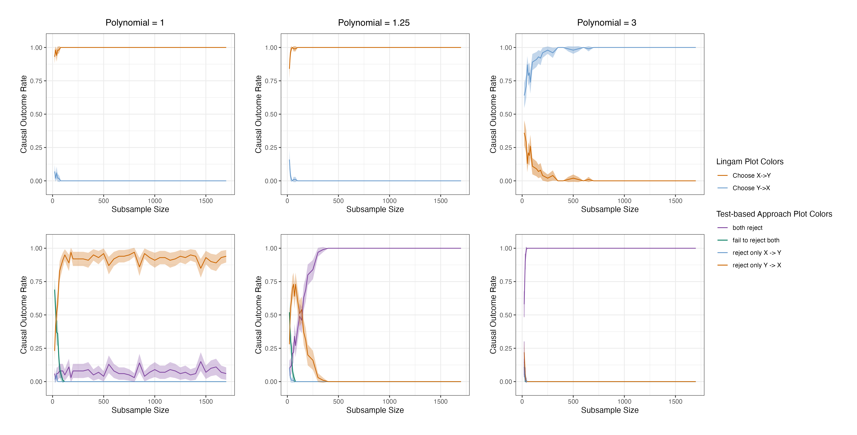
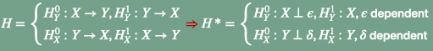
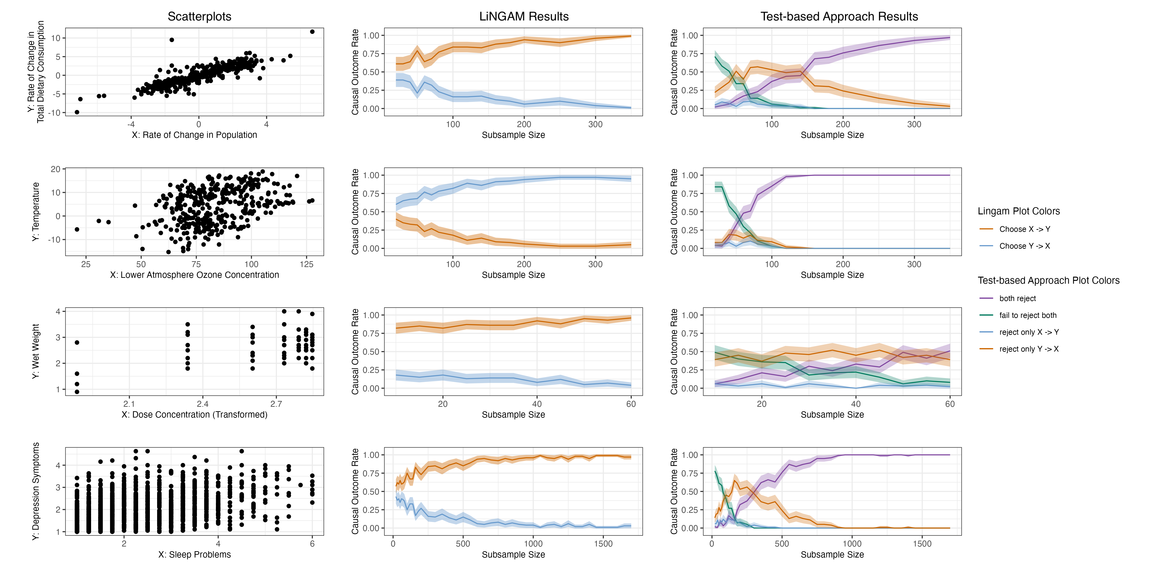
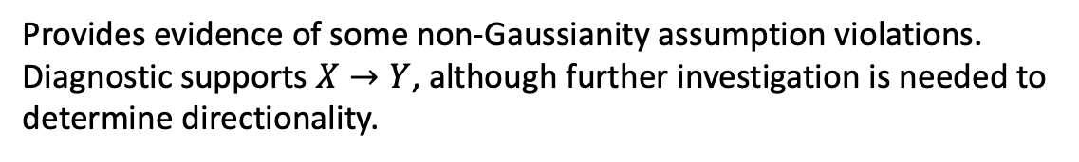


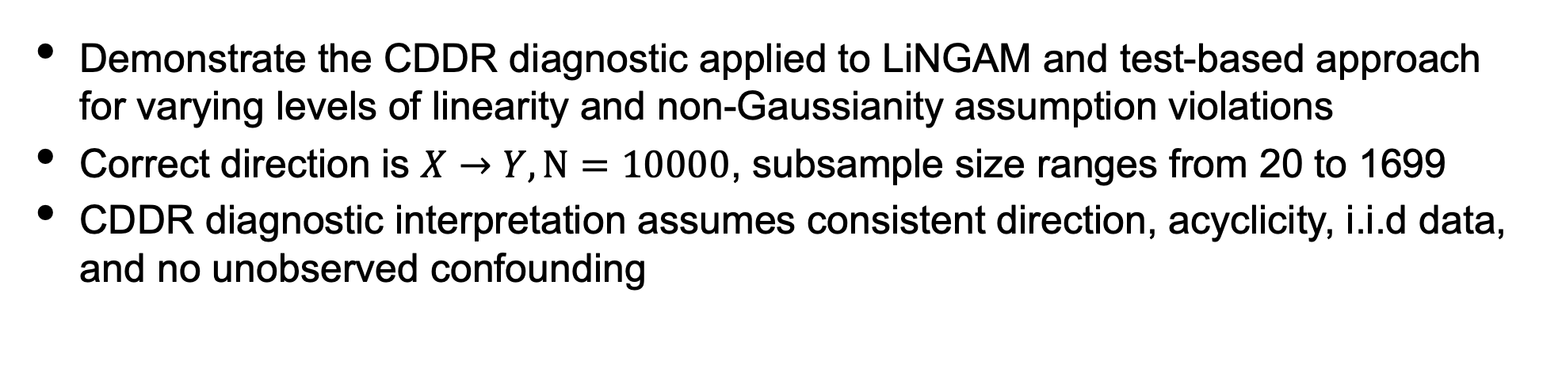
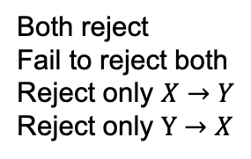
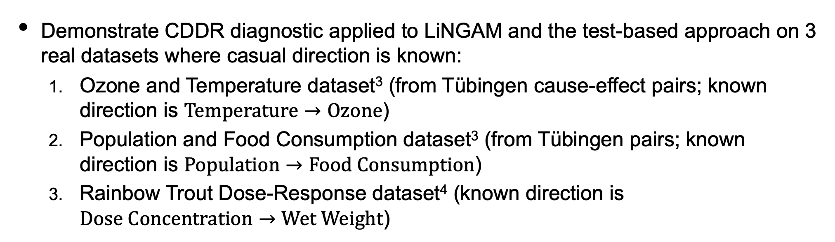

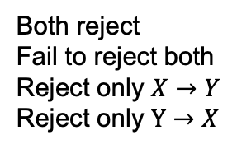
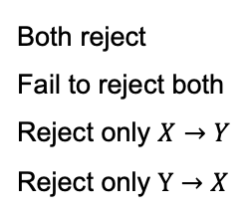
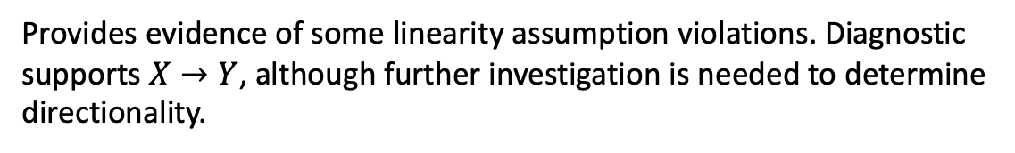
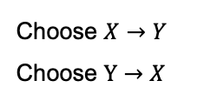
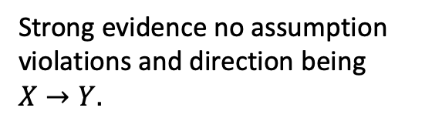

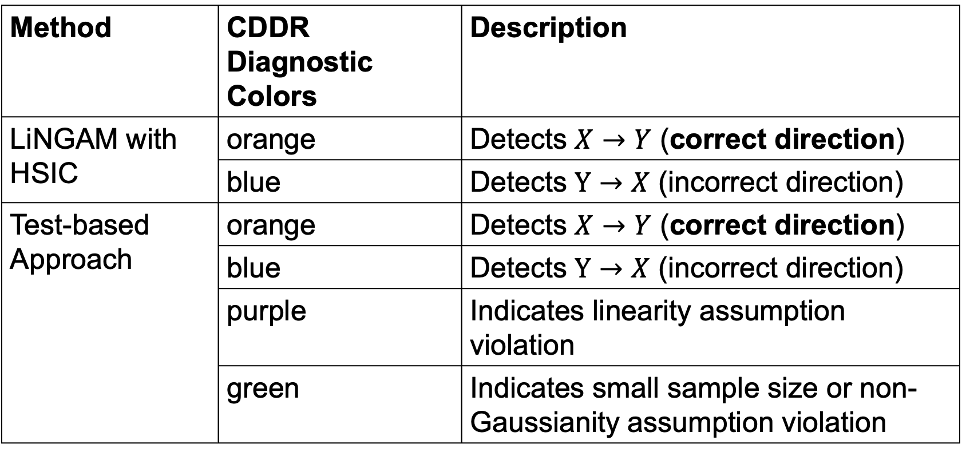
Towards Causal Discovery with Statistical Guarantees
S. Prakash^{1*}, F. Xia², E. Erosheva¹
1 University of Washington, Seattle, Washington; *shreyap1@uw.edu
2 University of California San Francisco, San Francisco, California
INTRODUCTION
RESULTS
Simulation Results
Functional causal discovery methods aim to infer causal direction from the data given certain distributional assumptions.
There exists no diagnostic tool to assess assumption violations and their impact on detecting the causal direction.
We propose the Causal Direction Detection Rate (CDDR) diagnostic to address this need.
Key observation: Impacts of assumption violations on inferred directionality depends on sample size:
Small sample sizes may lead to indeterminate results due to insufficient information about causal directionality.
Large sample sizes with subtle assumption violations may obscure detecting causal direction signal.
Strong evidence in favor of non-Gaussianity holding.
Functional causal discovery methods aim to infer causal direction from the data given certain distributional assumptions.
There exists no diagnostic tool to assess assumption violations and their impact on detecting the causal direction.
We propose the Causal Direction Detection Rate (CDDR) diagnostic to address this need.
Key observation: Impacts of assumption violations on inferred directionality depends on sample size:
Small sample sizes may lead to indeterminate results due to insufficient information about causal directionality.
Large sample sizes with subtle assumption violations may obscure detecting causal direction signal.
Simulation Setup
Demonstrate the CDDR diagnostic applied to LiNGAM and test-based approach for varying levels of linearity and non-Gaussianity assumption violations
Correct direction is $X→Y, N=10000$, subsample size ranges from 20 to 1699
CDDR diagnostic interpretation assumes consistent direction, acyclicity, i.i.d data, and no unobserved confounding
LiNGAM CDDR Diagnostic Colors
Choose $X→Y$
Choose $Y→X$
Strong evidence of non-Gaussianity assumption violations. Inconclusive direction.
METHODS
METHODS
Test-based Approach CDDR Diagnostic Colors
METHODS
Our proposed Causal Direction Detection Rate (CDDR) diagnostic
Measures uncertainty in causal direction as a function of sample size
Applicable to any functional causal discovery method
Is consistent and exhibits CLT properties under some assumptions
Simulation settings for varying levels of non-Gaussianity. GMM(k=3) corresponds to non-Gaussian. GMM(k=2) corresponds to slightly non-Gaussian. Gaussian corresponds to Gaussian setting.
Simulation settings for varying levels of linearity. Polynomial = 1 corresponds to linear setting. Polynomial = 1.25 corresponds to slightly nonlinear. Polynomial = 3 corresponds to nonlinear.
Both reject
Fail to reject both
Reject only $X→Y$
Reject only $Y→X$
CDDR Diagnostic Interpretation
Causal Discovery Methods
Method | CDDR Diagnostic Colors | Description
LiNGAM with HSIC | orange | Detects $X→Y$ (correct direction)
 | blue | Detects $Y→X$ (incorrect direction)
Test-based Approach | orange | Detects $X→Y$ (correct direction)
 | blue | Detects $Y→X$ (incorrect direction)
 | purple | Indicates linearity assumption violation
 | green | Indicates small sample size or non-Gaussianity assumption violation
Strong evidence no assumption violations and direction being $X→Y.$
Provides evidence of some non-Gaussianity assumption violations. Diagnostic supports $X→Y$, although further investigation is needed to determine directionality.
Linear Non-Gaussian Acyclic Model (LiNGAM)¹ and the Test-based Approach
Additive Noise Models (ANM)
Post-Nonlinear Causal Model (PNL)
LiNGAM CDDR Diagnostic Colors
Test-based
Choose $X→Y$
Choose $Y→X$
Uses hypothesis tests to determine the causal direction:
Compares p-value estimated from $H$* to significance level
Examples: Real Data
Cannot say much about linearity assumption violations
Demonstrate CDDR diagnostic applied to LiNGAM and the test-based approach on 3 real datasets where casual direction is known:
Ozone and Temperature dataset³ (from Tübingen cause-effect pairs; known direction is $Temperature→Ozone$)
Population and Food Consumption dataset³ (from Tübingen pairs; known direction is $Population→Food Consumption$)
Rainbow Trout Dose-Response dataset⁴ (known direction is $Dose Concentration→Wet Weight$)
Assumes
Uses linear regression to decide between
$X→Y⇒Y=βX+ε, X⊥ε$
$Y→X⇒X=γY+η, Y⊥η$
Test-based Approach CDDR Diagnostic Colors
Linearity
Non-Gaussianity
I.I.D data
Acyclicity
No unobserved confounding
Both reject
Fail to reject both
Reject only $X→Y$
Reject only $Y→X$
Real Data Results
Compares “test-statistics” (e.g. mutual information) between directions
Provides evidence of some linearity assumption violations. Diagnostic supports $X→Y$, although further investigation is needed to determine directionality.
Strong evidence of linearity assumption violations. Inconclusive direction.
LiNGAM
CDDR Diagnostic Interpretation
Real Data CDDR Diagnostic: Conclusions
CONTRIBUTIONS
Ozone and Temperature dataset
LiNGAM favors incorrect direction due to assumption violations.
Detects moderate to severe linearity assumption violations; inconclusive direction for Test-based Approach.
Population and Food Consumption dataset
Both methods favor correct direction.
Evidence of linearity assumption violations with the Test-based Approach.
No assumption violations detected with LiNGAM.
Rainbow Trout Dose-Response dataset
Both methods support correct direction
With the Test-based Approach, detects minor linearity assumption violations due to the inevitable non-linearities in real data.
No assumption violations detected with LiNGAM
CDDR Diagnostic: first diagnostic tool for causal discovery to evaluate assumption violations as a function of sample size.
Applicable to any bivariate functional causal discovery method.
CDDR diagnostic is especially effective when paired with a causal discovery method that provides more than just a deterministic direction such as our proposed Test-based Approach.
REFERENCES
1 Shimizu et al. Journal of Machine Learning Research. 2006.
2 Sen & Sen. Biometrika. 2014
3 Mooji et al. Journal of Machine Learning Research. 2016.
4 Ritz et al. PloS one. 2015.
LiNGAM Plot Colors
Test-based Approach CDDR Diagnostic Colors
Choose $X→Y$
Choose $Y→X$
Both reject
Fail to reject both
Reject only $X→Y$
Reject only $Y→X$

